Slide 1
Clock, clock, clock,
A dog plays with a frog,
The frog plays with the dog,
Clock, clock, clock.

Slide 2
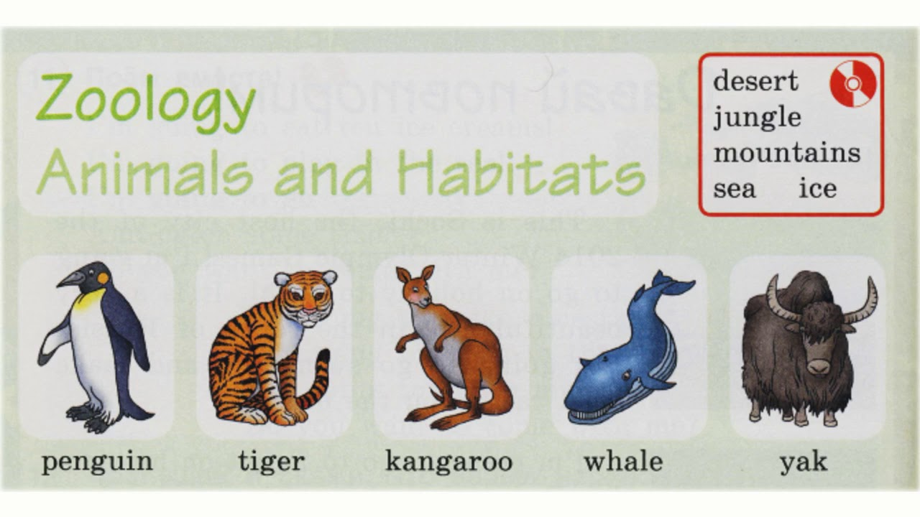

Slide 3
Desert – пустыня
Jungle – джунгли
Mountains – горы
Sea – море
Ice – лёд
Penguin – пингвин
Tiger – тигр
Kangaroo – кенгуру
Whale – кит
Yak – як

Slide 4
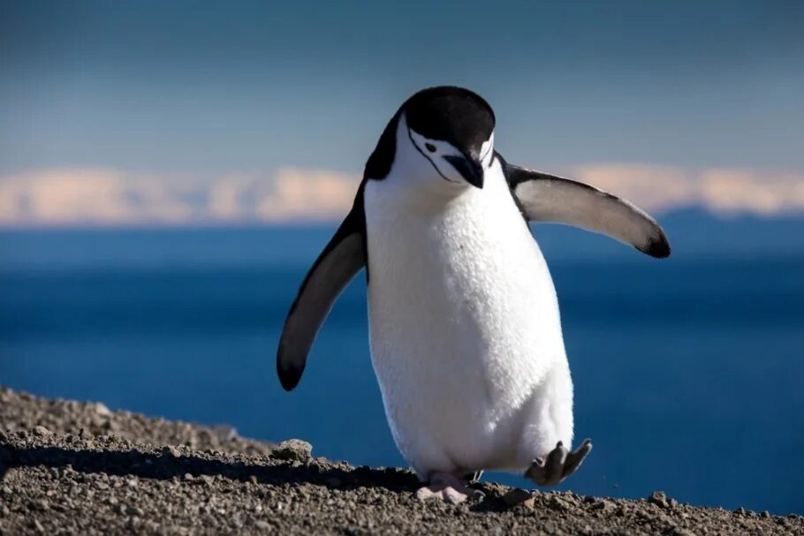

Slide 5
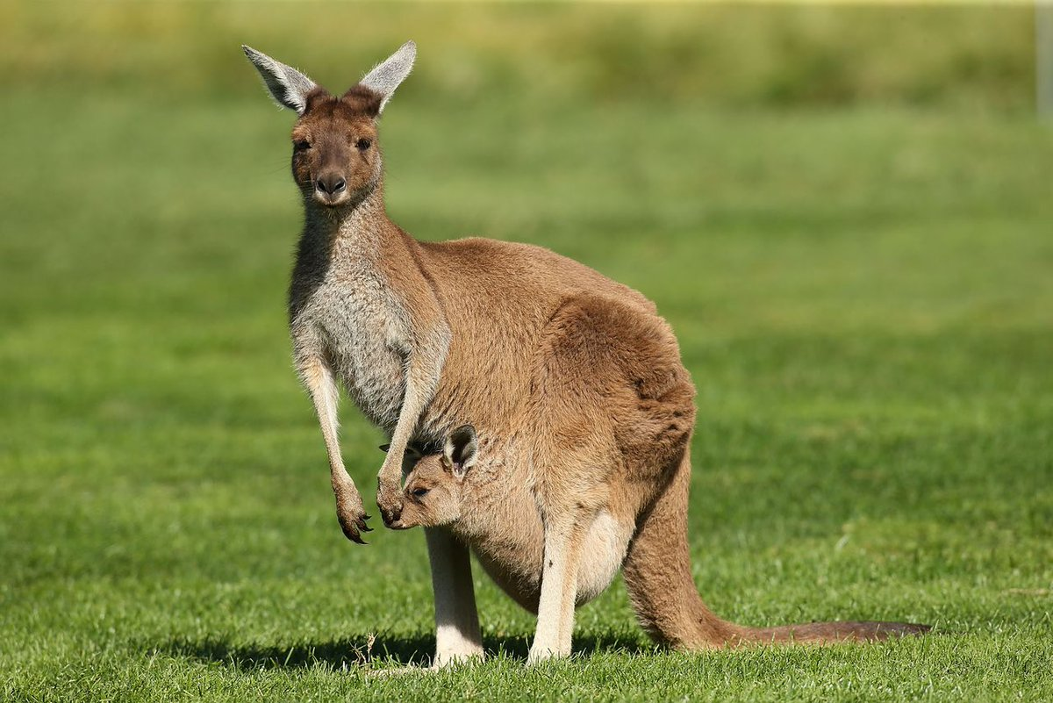

Slide 6
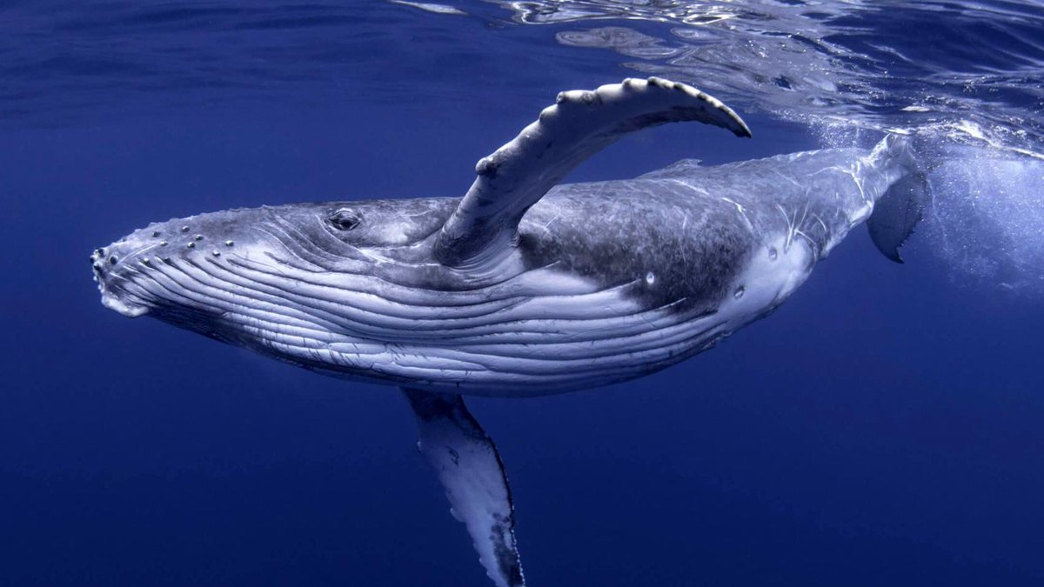

Slide 7
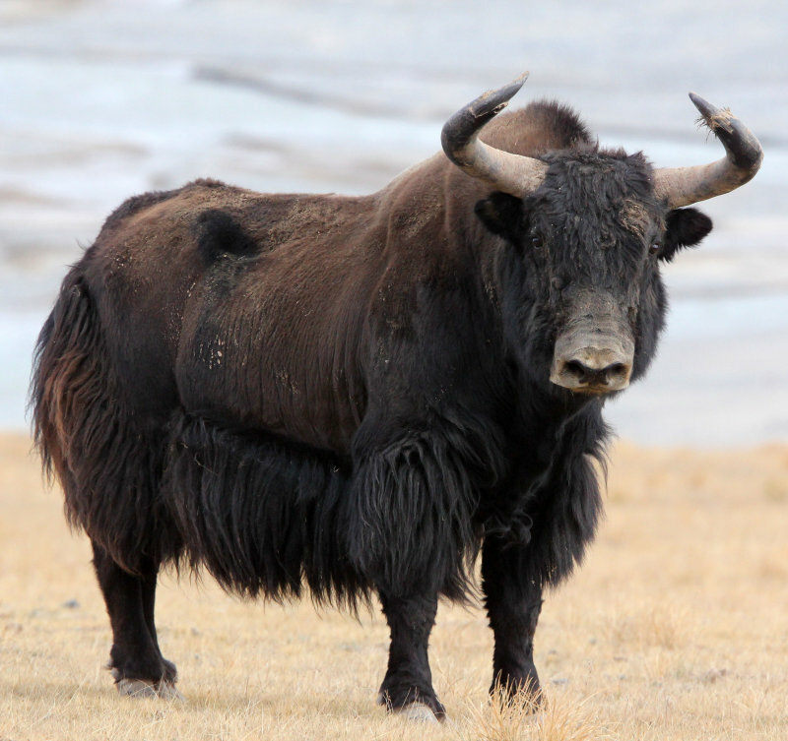

Slide 8
